Slide 1
Android Activity and Intent

Slide 2
Activity Outline
Concept
Lifecycle and callbacks
Manifest
Task and stack

Slide 3
Concept
An activity is the entry point for interacting with the user. It represents a single screen with a user interface.
For example, an email app
one activity that shows a list of new emails
another activity to compose an email
and another activity for reading emails.
Although the activities work together to form a cohesive user experience in the email app, each one is independent of the others.

Slide 4
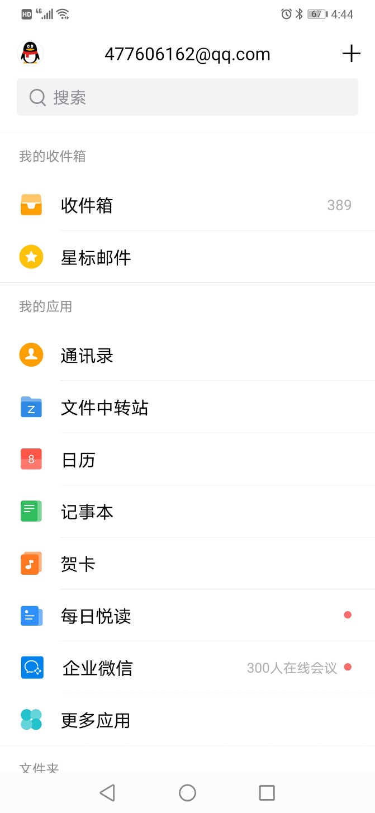



Slide 5
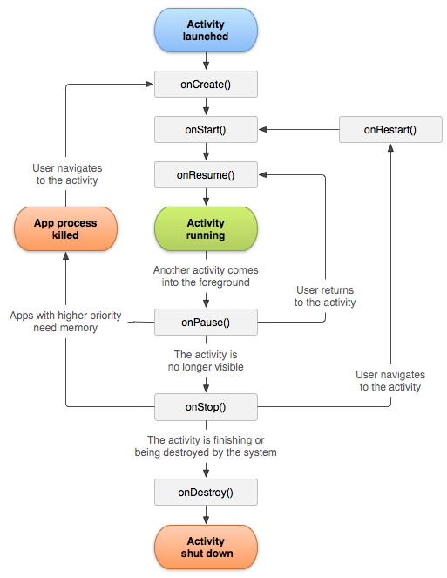
Lifecycle callbacks (super important)
What a wonderful life!!
Questions:
What is callback?
How many callbacks?
Conditions for onCreate to onStart, and so on?
Conditions for killed by system? The key factor?
Usage of the callbacks?

Slide 6
Lifecycle callbacks
Within the lifecycle callback methods, you can declare how your activity behaves when the user leaves and re-enters the activity.
For a video player
pause the video and terminate the network connection when the user switches to another app.
When the user returns, you can reconnect to the network and allow the user to resume the video from the same spot.
each callback allows you to perform specific work that's appropriate to a given change of state.
Doing the right work at the right time and handling transitions properly make your app more robust and performant.

Slide 7
Bad examples
Consuming valuable system resources when the user is not actively using it.
Losing the user's progress if they leave your app and return to it at a later time.
Crashing or losing the user's progress when the screen rotates between landscape and portrait orientation.

Slide 8
How to do the right work?
It is too big and complex for this class
Handling Lifecycles with Lifecycle-Aware Components
https://developer.android.google.cn/topic/libraries/architecture/lifecycle
Saving UI States
https://developer.android.google.cn/topic/libraries/architecture/saving-states
Guide to App Architecture
https://developer.android.google.cn/jetpack/docs/guide

Slide 9
onCreate()
You must implement this callback
you must call setContentView() to define the layout for the activity's user interface
Your implementation should initialize the essential components of your activity

Slide 10
onStart()
the activity enters the Started state, and the activity becomes visible to the user.
This callback contains what amounts to the activity’s final preparations for coming to the foreground and becoming interactive.

Slide 11
onResume()
The system invokes this callback just before the activity starts interacting with the user.
At this point, the activity is at the top of the activity stack, and captures all user input.
Most of an app’s core functionality is implemented in the onResume() method.

Slide 12
onPause()
The system calls onPause() when the activity loses focus and enters a Paused state.
This state occurs when, for example, the user taps the Back or Recents button.
When the system calls onPause() for your activity, it technically means your activity is still partially visible, but most often is an indication that the user is leaving the activity, and the activity will soon enter the Stopped or Resumed state.

Slide 13
onPause()
An activity in the Paused state may continue to update the UI if the user is expecting the UI to update.
You should not use onPause() to save application or user data, make network calls, or execute database transactions. For information about saving data.
Why??

Slide 14
onStop()
The system calls onStop() when the activity is no longer visible to the user.
This may happen because
the activity is being destroyed, a new activity is starting,
or an existing activity is entering a Resumed state and is covering the stopped activity.
You should use onStop() to perform relatively CPU-intensive shutdown operations. For example, to save information to a database.

Slide 15
onRestart()
The system invokes this callback when an activity in the Stopped state is about to restart.
onRestart() restores the state of the activity from the time that it was stopped.

Slide 16
onDestroy()
The system invokes this callback before an activity is destroyed.
This callback is the final one that the activity receives.
onDestroy() is usually implemented to ensure that all of an activity’s resources are released when the activity, or the process containing it, is destroyed.

Slide 17
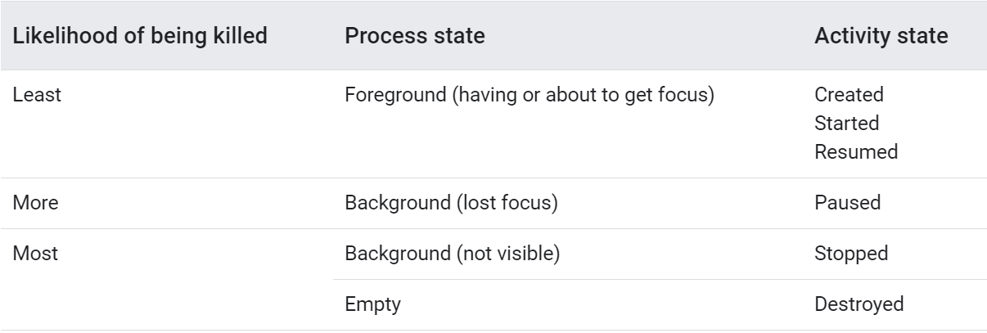
Activity state and ejection from memory
The system kills processes when it needs to free up RAM
the likelihood of the system killing a given process depends on the state of the process at the time

Slide 18
Task and stack
A task is a collection of activities that users interact with when performing a certain job
The activities are arranged in a stack—the back stack

Slide 19
Click Back Button, what should happen?

Slide 20
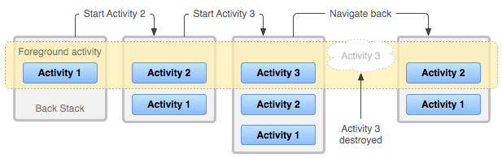
After activity 1 starts activity 2, what states may activity 1 go through?
After navigating back, what states may activity 3 and activity 2 go through?

Slide 21
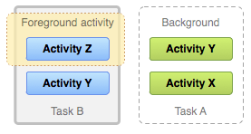
A task is a cohesive unit that can move to the "background" when users begin a new task or go to the Home screen, via the Home button.

Slide 22
Configuring the manifest
Declare activities
LaunchMode
Permission

Slide 23
Declare activities
The only required attribute for this element is android:name
<manifest ... > <application ... > <activity android:name=".ExampleActivity" /> ... </application ... > ... </manifest >

Slide 24
LaunchMode
Read page 157 – 160 in 5min, and find answers for below questions
How many types of LaunchMode for activity? What are they?
What are the similarities and differences between standard mode and singleTop mode? Any examples?
What are the similarities and differences between singleTask mode and singleInstance mode? Any examples?

Slide 25
Permission
Read page 160 – 163 in 3min, and find answers for below questions
In real life, have you met anything related to activity permission?
How to set uses permission?

Slide 26
Intents
Introduction
Types
Building an intent
Common Intents

Slide 27
Intent
An Intent is a messaging object you can use to request an action from another app component.
three fundamental use cases:
Starting an activity
Starting a service
Delivering a broadcast

Slide 28
Building an intent
An Intent object carries information that the Android system uses to determine which component to start
exact component name or component category that should receive the intent
plus information that the recipient component uses in order to properly perform the action (such as the action to take and the data to act upon)
Read page 206 – 207, and find following questions:
How many types of information in an Intent?
Common data types?

Slide 29
Intent types
Explicit intents
specify which application will satisfy the intent, by supplying either the target app's package name or a fully-qualified component class name.
Implicit intents
do not name a specific component, but instead declare a general action to perform, which allows a component from another app to handle it

Slide 30
Read page 208
How do Explicit intents set the activity to start?
How do Implicit intents set the activity to start?
What is intent filter’s role?

Slide 31
Common Intents
Read page 211 – 212
What are common steps of using Common Intents to do the right work?

Slide 32
Take home message
Lifecycle callbacks
intent types

Slide 33
Homework 4
Page 218-222
Let the example app run appropriately, and send the codes and results with e-mail
The deadline next Monday night.

Slide 34
Problems
How to Validate the phone number?
0734-123456
How to Validate the e-mail address?
123@
123.com
123@163
123@163.com
123@163.cn

Slide 35
Java Regex/Regular Expression
A regular expression (regex) defines a search pattern for strings
A regex can be used to search, edit and manipulate text
The search pattern can be anything
a simple character
a fixed string
a complex expression containing special characters describing the pattern
One online tool: https://regex101.com/

Slide 36
Rules of writing regular expressions
Common matching symbols
Meta characters
Quantifier
Negative look ahead
Modes
Capturing Group

Slide 37
Common matching symbols
Regular Expression | Description
^regex | Finds regex that must match at the beginning of the line.
regex$ | Finds regex that must match at the end of the line.
[abc] | Set definition, can match the letter a or b or c.
[^abc] | When a caret appears as the first character inside square brackets, it negates the pattern. This pattern matches any character except a or b or c.
[a-d1-7] | Ranges: matches a letter between a and d and figures from 1 to 7, but not d1.
X|Z | Finds X or Z.

Slide 38
Meta characters
Regular Expression | Description
. | Matches any character
\d | Any digit, short for [0-9]
\D | A non-digit, short for [^0-9]
\s | A whitespace character, short for [ \t\n\x0b\r\f]
\S | A non-whitespace character, short for
\w | A word character, short for [a-zA-Z_0-9]
\W | A non-word character [^\w]
\S+ | Several non-whitespace characters
\b | Matches a word boundary where a word character is [a-zA-Z0-9_]
meta characters have a pre-defined meaning and make certain common patterns easier to use.
For example, you can use \d as simplified definition for [0..9].
These meta characters have the same first letter as their representation, e.g., digit, space, word, and boundary. Uppercase symbols define the opposite.

Slide 39
Quantifier
A quantifier defines how often an element can occur.
Regular Expression | Description | Examples
{X} | Occurs X number of times | \d{3} searches for three digits, .{10} for any character sequence of length 10.
{X,} | Occurs more than X times,
{X,Y} | Occurs between X and Y times, | \d{1,4} means \d must occur at least once and at a maximum of four.
+ | Occurs one or more times, is short for {1,} | X+- Finds one or several letter X
? | Occurs no or one times, ? is short for {0,1}. | X? finds no or exactly one letter X

Slide 40
Backslashes in Java
The backslash \ a predefined meaning in Java
use double backslash \\ to define a single backslash
To define \w, write \\w
If you want to use backslash as a literal, you have to type \\\\ as \ is also an escape character in regular expressions.

Slide 41
Negative look ahead
Negative look ahead provides the possibility to exclude a pattern.
With this you can say that a string should not be followed by another string.
Negative look ahead are defined via (?!pattern).

Slide 42
modes inside the regular expression
You can add the mode modifiers to the start of the regex. To specify multiple modes, simply put them together as in (?ismx).
(?i) makes the regex case insensitive.
(?s) for "single line mode" makes the dot match all characters, including line breaks.
(?m) for "multi-line mode" makes the caret and dollar match at the start and end of each line in the subject string

Slide 43
Capturing Group
You can group parts of your regular expression with round brackets, e.g., ().
these groups create a back reference to the part of the regular expression.
A back reference stores the part of the String which matched the group. This allows you to use this part in the replacement.

Slide 44
regular expressions with String methods
Method | Description
s.matches("regex") | Evaluates if "regex" matches s. Returns only true if the WHOLE string can be matched.
s.split("regex") | Creates an array with substrings of s divided at occurrence of "regex". "regex" is not included in the result.
s.replaceFirst("regex", "replacement") | Replaces first occurance of "regex" with "replacement.
s.replaceAll("regex", "replacement") | Replaces all occurances of "regex" with "replacement.

Slide 45
public static final String EXAMPLE_TEST = "This is my small example " + "string which I'm going to " + "use for pattern matching."; public static void main(String[] args) { System.out.println(EXAMPLE_TEST.matches("\\w.*")); String[] splitString = (EXAMPLE_TEST.split("\\s+")); System.out.println(splitString.length);// should be 14 for (String string : splitString) { System.out.println(string); } // replace all whitespace with tabs System.out.println(EXAMPLE_TEST.replaceAll("\\s+", "\t")); }

Slide 46
Pattern and Matcher
For advanced regular expressions the java.util.regex.Pattern and java.util.regex.Matcher classes are used.
First create a Pattern object which defines the regular expression.
This Pattern object allows you to create a Matcher object for a given string.
This Matcher object then allows you to do regex operations on a String.

Slide 47
public static final String EXAMPLE_TEST = "This is my small example string which I'm going to use for pattern matching."; public static void main(String[] args) { Pattern pattern = Pattern.compile("\\w+"); // in case you would like to ignore case sensitivity, // you could use this statement: // Pattern pattern = Pattern.compile("\\s+", Pattern.CASE_INSENSITIVE); Matcher matcher = pattern.matcher(EXAMPLE_TEST); // check all occurance while (matcher.find()) { System.out.print("Start index: " + matcher.start()); System.out.print(" End index: " + matcher.end() + " "); System.out.println(matcher.group()); } // now create a new pattern and matcher to replace whitespace with tabs Pattern replace = Pattern.compile("\\s+"); Matcher matcher2 = replace.matcher(EXAMPLE_TEST); System.out.println(matcher2.replaceAll("\t")); }

Slide 48
More examples
Finding duplicated words
One text and two text
\b(\w+)\s+\1\b
Phone number validation
1234567890
123-456-7890
123-456-7890
123-456-7890
(123)-456-7890
123.456.7890
123,456,7890
123 456 7890

